Slide 1

Global Analysis of Acute Food Insecurity
An In-depth Analysis of IPC Data
Group B11 Programming for Data Scientists
Richard Gidi 22424288 (Group Leader) Theresa Sackey 22424230
Ebenezer Botwi 22429815
Solomon Djaba 22424682 Adams Amadu Diiwu 2242423
Global Analysis of Acute Food Insecurity

Slide 2
Problem Statement & Data Source
Objective: To analyze global trends, regional disparities, and volatility in acute food insecurity using the Integrated Food Security Phase Classification (IPC) framework.
Data Source: IPC (Integrated Food Security Phase Classification) dataset.
Timeframe: 2017 – Present.
Technical Challenge: Irregularity–unlike standard time-series (monthly/daily), IPC assessments occur irregularly (every 49 months).
Metric Definition: Crisis+ = Phase 3 (Crisis) + Phase 4 (Emergency) + Phase 5 (Catastrophe)
Global Analysis of Acute Food Insecurity

Slide 3
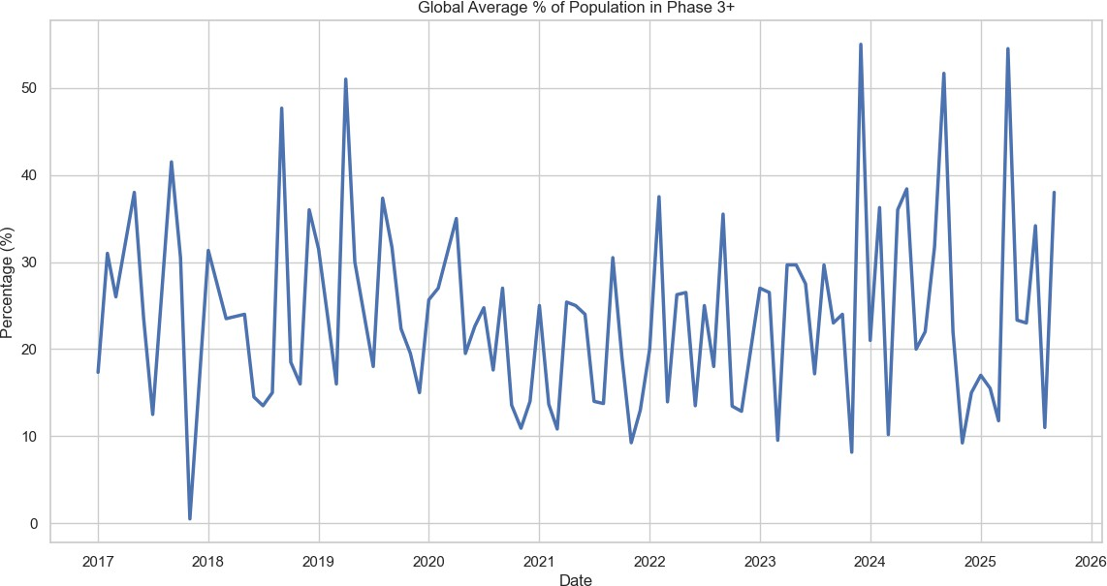
Global Insecurity is Volatile, Not Linear
Finding: There is no smooth, predictable upward or downward trend. The global average is defined by high volatility.
The "Shock" Factor: Significant spikes are observed post-2020, correlating with global stressors (pandemic, supply chain disruptions, conflict).
Note that countries with higher severity also tend to show higher volatilitythe most vulnerable are also the most unstable.
Global Analysis of Acute Food Insecurity

Slide 4
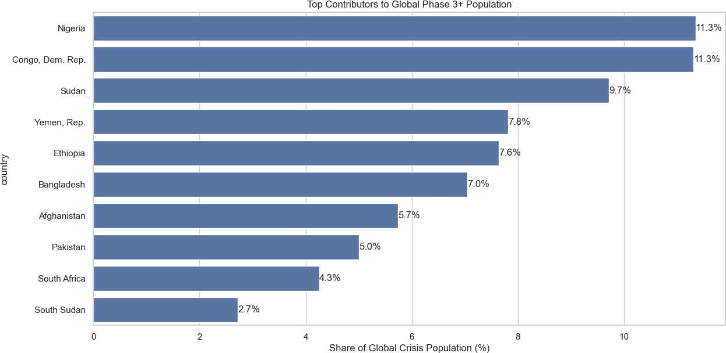
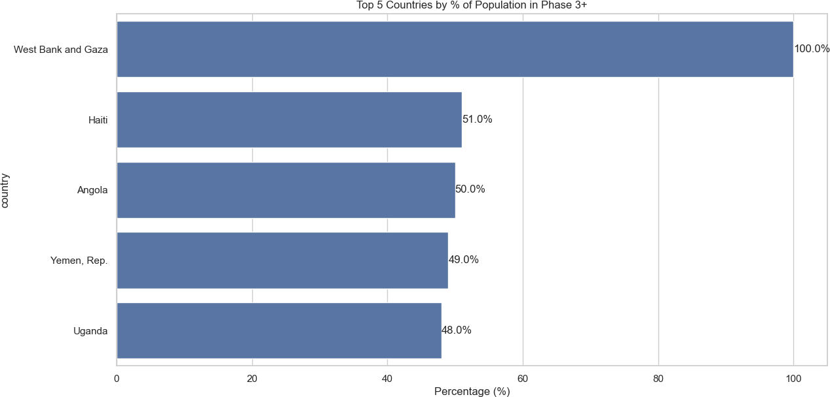
Scale vs. Severity: Two Faces of Hunger
Highest Total Population (Millions) Highest Percentage of Population (%)
Volume ≠ Severity: The countries with the most people in hunger are rarely the ones with the highest percentages.
The Resource Paradox: A 10% crisis in a giant nation (like Nigeria) requires more food tonnage than a 50% crisis in a smaller nation.
Global Analysis of Acute Food Insecurity

Slide 5
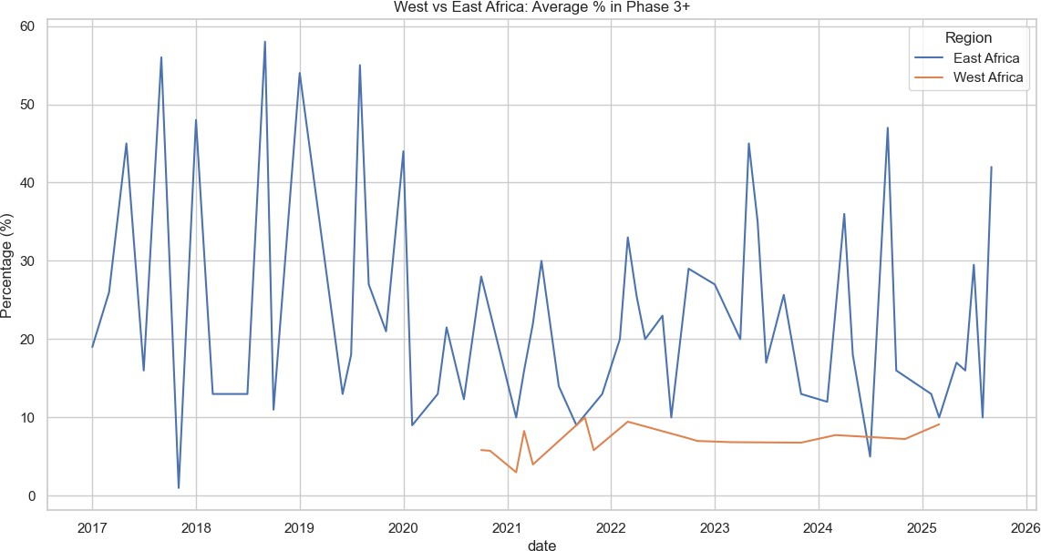
Regional Analysis: A Tale of Two Regions
Comparison: A direct statistical comparison of food insecurity distributions in these two key regions; East Africa and West Africa.
West Africa: Higher variance; sensitive to recent market and conflict shocks.
East Africa: consistently high median; driven by chronic climate cycles.
Global Analysis of Acute Food Insecurity

Slide 6
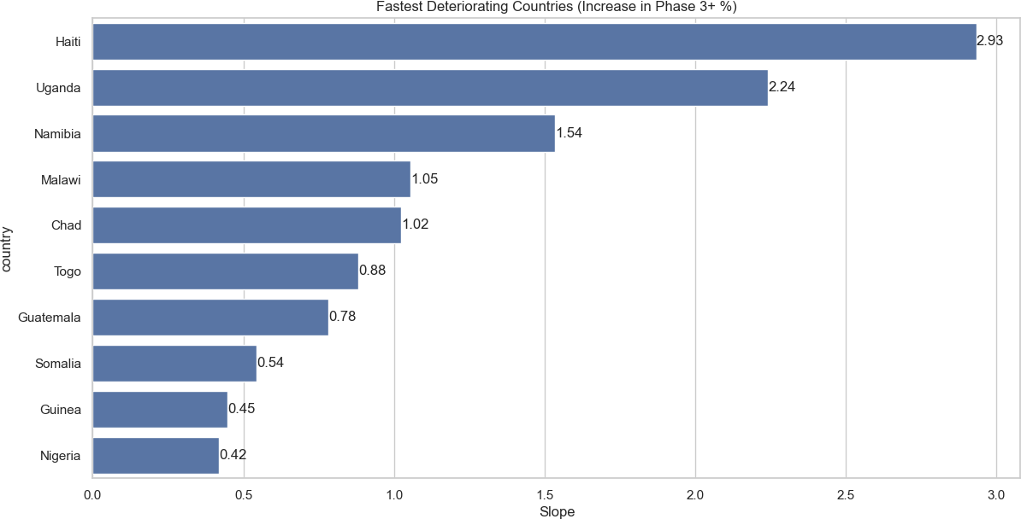
The Fastest Deterioration
Key Insight: Identifying where the situation is worsening most rapidly.
The Metric: We calculated the "Slope" (rate of change) for every country. A high positive slope indicates rapid deterioration.
Action Required: These countries require preventive intervention before they hit famine levels.
Global Analysis of Acute Food Insecurity

Slide 7
Signs of Resilience: Learning from Recovery
Table 1: Countries Showing Strongest Evidence of Recovery (Negative Slope)
Rank | Country | Recovery Slope
1 | Pakistan | -2.950
2 | Madagascar | -1.203
3 | Sierra Leone | -0.321
4 | Burundi | -0.311
5 | Guinea-Bissau | -0.255
6 | Yemen, Rep. | -0.250
7 | Burkina Faso | -0.214
8 | Central African Republic | -0.150
9 | Kenya | -0.126
10 | Afghanistan | -0.031
Key Insight: Statistical evidence that recovery is possible.
The Metric: A negative slope indicates a consistent reduction in the percentage of the population in crisis.
Global Analysis of Acute Food Insecurity

Slide 8
Conclusion & Recommendations
Summary:
Volatility: The crisis is driven by shocks, not smooth trends.
Duality: The crisis has two facesVolume (Logistics) vs. Intensity (Urgency). We cannot treat them the same.
Geography: Solutions must be regionally tailored; West Africa’s instability differs from East Africa’s climate cycles.
Recommendations:
Agile Funding: Move away from static annual budgets to shock-responsive financing that matches global volatility.
Bifurcated Strategy:
  For High Volume: Prioritize supply chain efficiency.
  For High Intensity: Prioritize humanitarian access and protection.
Global Analysis of Acute Food Insecurity

